Slide 1

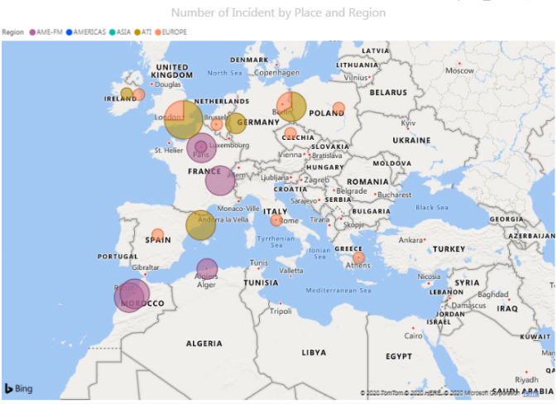
Why Data Visualization is critical to Your Organization
The Human Brain Processes Visual INFORMATION 60,000X Faster than Text
Data Visualization is a graphical representation of the information collected through data analysis. The data can give you the clear insight when it is been shown in visual context through Map/Graphs.
When it comes to Turing your data into tangible action for your organization for first step is data visualization Because if you want to take a step forward, you have to be able to see big picture behind your data.
Below are the list of reason why it is critical to your Organization
#1) Data visualization conveys your Message
Turning data analysis into visual representations such as charts, graphs, and histograms to more easily consume data.

Slide 2
